Slide 7
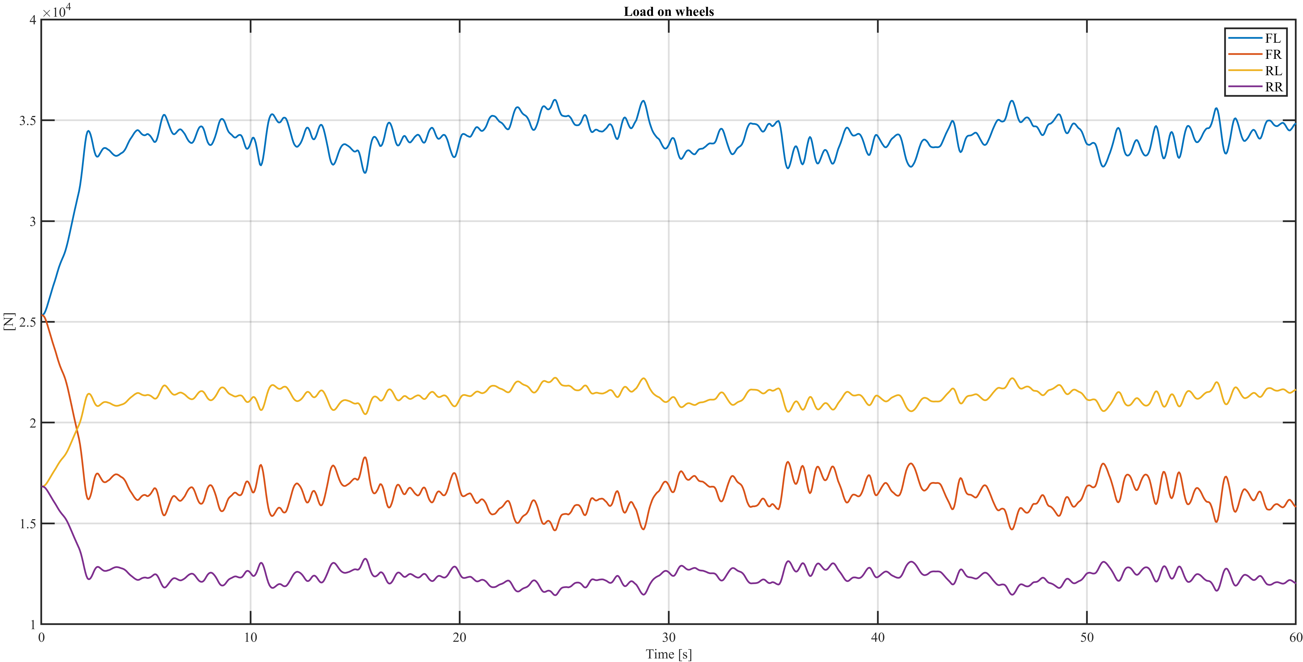
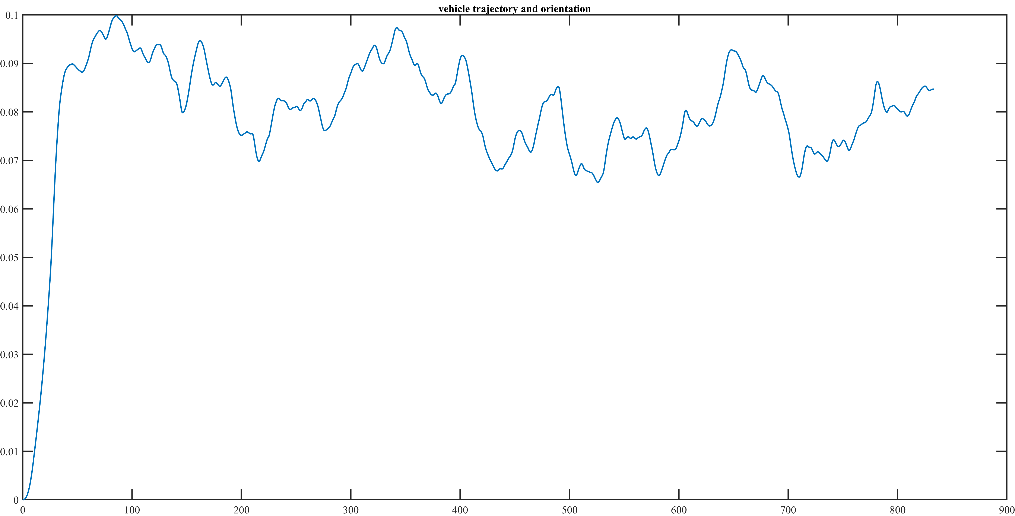
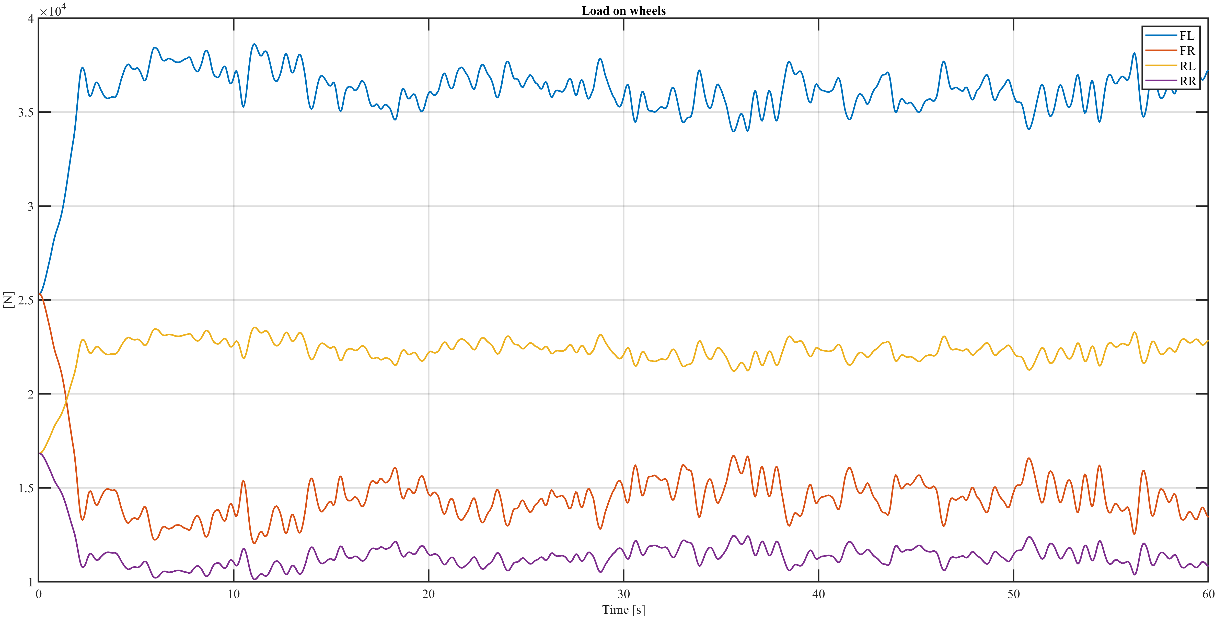
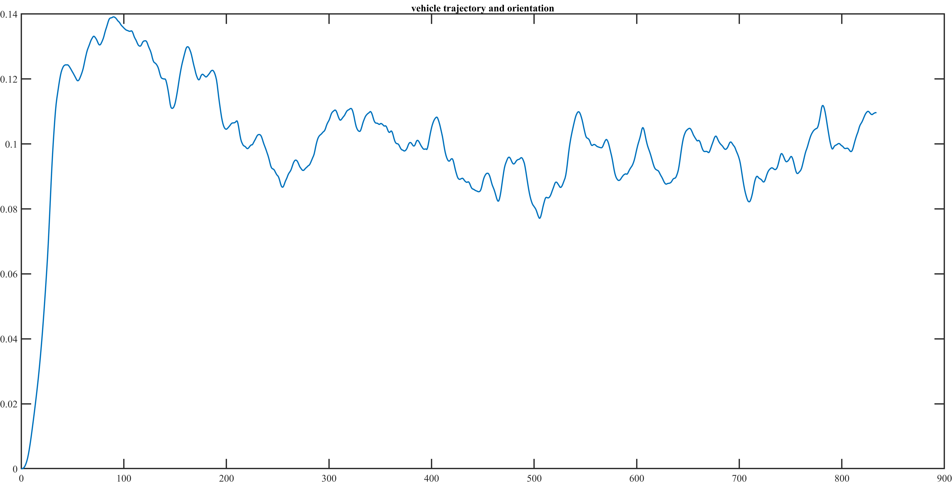
Main results analysis
Analysis of six different wind histories in different meteorological conditions (dry, wet and snow)
Comparison between wind history 1 and 4 in dry condition – same turbulence intensity, but different wind speed
The trends of the forces and aerodynamic moment in the two cases are similar, while the modulus changes considerably
[WH 1 on top, WH 4 on bottom]
As can be seen from the trajectory plot, in the second case the truck is more unbalanced
[WH 1 on top, WH 4 on bottom]

Slide 8
Main results analysis
Analysis of six different wind histories in different meteorological conditions (dry, wet and snow)
Comparison between wind history 1 and 3 in dry condition – same wind speed, but different turbulence intensity

